Slide 1
Media ethics: oxymoron?
An introduction.

Slide 2
Media ethics?
Many people see media today as more unethical than ever:
Biased blogs.
Political lies.
Appealing to base emotions.
One-sided presentations.
Ad hominem arguments (attacking character)

Slide 3
Media ethics?
Yet journalists consider ethics a lot more than they used to.
In the 19th century, journalism ethics didn’t exist.
Editors in the only news media of the time, newspapers, felt free to attack each other:
“We challenge the world to produce a more contemptible lot of whelps than those which vegetate about the Sun office.”
—Cheyenne Leader, 3 July 1892, 2, editorial, criticizing a competitor.

Slide 4
Media ethics?
Objectivity didn’t exist.
News according to the Republicans, or the Whigs, or abolitionists.
“Views, not news.”
Note: the U.S. Constitution doesn’t require fairness or objectivity.

Slide 5
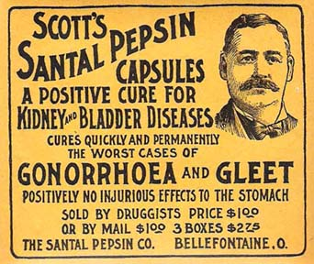
Media ethics?
Advertisers claimed all sorts of potions to cure any disease, from cancer to catarrh.
Alcohol, cocaine or opium often was a main ingredient. At least people couldn’t complain the drug had no effect!

Slide 6
Media ethics?
Today we would be shocked at such unethical behavior. Truly, the media has actually become more ethical in the last century.
Why? Because the profession developed a sense of journalism ethics.

Slide 7
Media ethics?
Journalism changed from small, artisanal, to large, industrial.
Small proprietors were squeezed out, bought.
By the 20th century, publishers could reach millions, true “mass media.”
If the press is concentrated in the hands of a few, what is freedom of the press?

Slide 8
Media ethics?
A call was made for greater responsibility among powerful publishers.
Publishers began separating opinion from news.
Government regulations controlled advertising claims.
Journalism became a profession, formally taught in journalism schools.

Slide 9
Media ethics?
The rise of journalism ethics coincided with the rise of professional journalism education in the 1920s.
Joseph Pulitzer endowed Columbia University School of Journalism, in hopes that journalism could become more than a herd of scribblers recruited from the gutter—their reputation at the time.

Slide 10
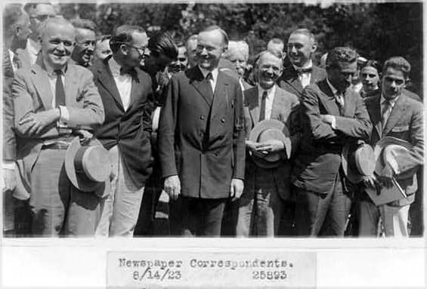
Media ethics?
If democracy were built on a free press, its journalists should be respected, ethical professional people.

Slide 11
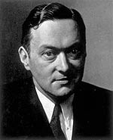
Media ethics?
Walter Lippmann was most famous among many writers calling for grater ethics in journalism after World War I (1914-1918).

Slide 12
Media ethics
To become more ethical, a standard code of ethics was proposed, similar in nature to that of doctors or lawyers. Early codes were produced by:
Society of Professional Journalists.
Society of Managing Editors.
National Association of Broadcasters.

Slide 13
Media ethics
Advertising diverged from journalism to become a separate profession.
Editors began to clearly indicate separation between advertising and non-advertising material.
Advertisers established their own ethical code, promising, at least, to tell the truth.

Slide 14
Media ethics
Patent medicines, that is, those potions promising to cure everything, became focus of muckraking articles.
Finally the U.S. Food and Drug Administration and Federal Trade Commission moved to regulate drug advertising, in early 1900s.

Slide 15
Media ethics
Public relations was a new field; ethical standards had not been set.
Public relations consultants at the turn of the last century mostly worked to eliminate bad publicity or keep bad news secret.
As a more enlightened PR formula began to attract more companies, the PRSA also set up a code of ethics.

Slide 16
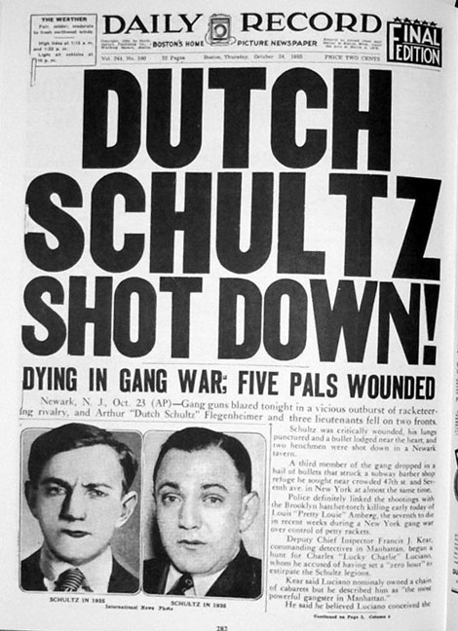
Media ethics
Advertisers were regulated by law. Journalists worried the same thing could happen to journalism.
People before World War II (1939-1945) were becoming fed up with the sensationalism and ethical excesses of the press.

Slide 17
Media ethics
Journalists’ fear that government could regulate print reasonable.
Broadcast was regulated air waves were considered public property. This was thought to open the door to media regulation.
If journalism were interpreted to be public service, it might be regulated.
Many editors believed journalism needed to establish better ethics standards to avoid government regulation.

Slide 18
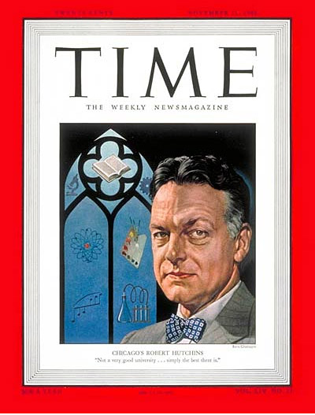
Media ethics
After World War II, the Hutchins Commission was asked to establish standards.
In 1947 it issued a report, A Free and Responsible Press. [http://www.ndsu.edu/pubweb/~rcollins/431ethics/hutchins.htm]

Slide 19
Media ethics
The Hutchins Commission report ushered in a golden age of journalism objectivity and responsibility.
Objectivity was THE standard. Reporters avoided interpretation or judgment.
But such objectivity sometimes led to its own problems.

Slide 20
Media ethics
Complete objectivity requires journalists to avoid commentary, even if they know the sources is lying or misleading.
During the 1950s “McCarthy Era,” politicians such as Joseph McCarthy was able to accuse people of being Communist. Objective journalists were constrained to report without comment.

Slide 21
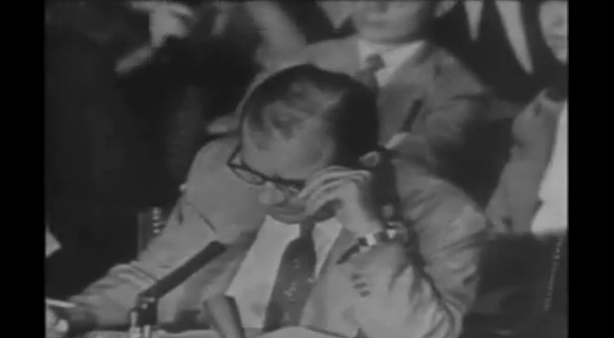
Media ethics
When you report without comment someone else’s lie, is that as bad as lying yourself?
On June 9, 1954, in a televised meeting, an attorney for the Army, Joseph Welch, accused of hiding Communists, responded to McCarthy. [http://www.youtube.com/watch?v=MO2iiovYq70&feature=related]

Slide 22
Media ethics
Many in the press were sent to soul-searching over their unquestioned devotion to objectivity. Interpretation might be a necessary part of ethics.
Edward R. Murrow, father of broadcast journalism, had already questioned a journalism ethics that protected people such as Joseph McCarthy.

Slide 23
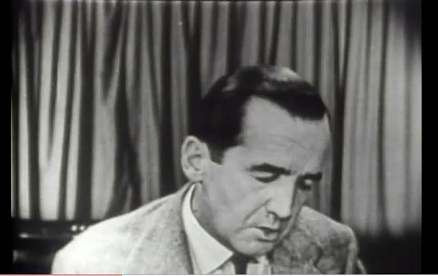
Media ethics
In 1954, Murrow decided to expose the lies in his news program, “See It Now.” [http://www.youtube.com/watch?v=anNEJJYLU8M]

Slide 24
Media ethics
As television became a powerful new medium, journalists reconsidered strict objectivity.
The Vietnam era tested the gullibility of journalists in reporting a war.
Investigative journalism became part of television with “60 Minutes.”
The beginning of television based sensational programs recalled the “tabloid journalism” of the 1920s.

Slide 25
Media ethics
The internet has snatched control away from legacy media. Now, anyone can call himself or herself a “journalist.”
Blogs, video uploads, online commentary, personal websites, social media—all of these can be part of today’s world of journalism.
But the credibility of journalism still seems to reside in the professional content creators.

Slide 26
Media ethics
Perhaps media ethics is a bell curve, from weak ethics, to great concern about ethics, back to weak ethics.
What would a blogger have to say about ethics of media on the internet? Here’s Chris Pirillo. [http://www.youtube.com/watch?v=jxfLdeu-3TU]

Slide 27
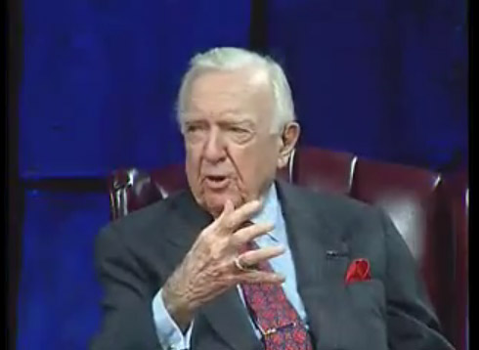
Media ethics
Has media ethics deteriorated in contemporary America?
Walter Cronkite thought “maybe.”
[http://www.youtube.com/watch?v=tlYIC6MU4-s]

Slide 28
Media ethics
What is the most ethical medium for news, in your opinion?
Television: what program?
Newspapers: which ones?
Magazines: which ones?
Online: which site?
Or…?

